Slide 1
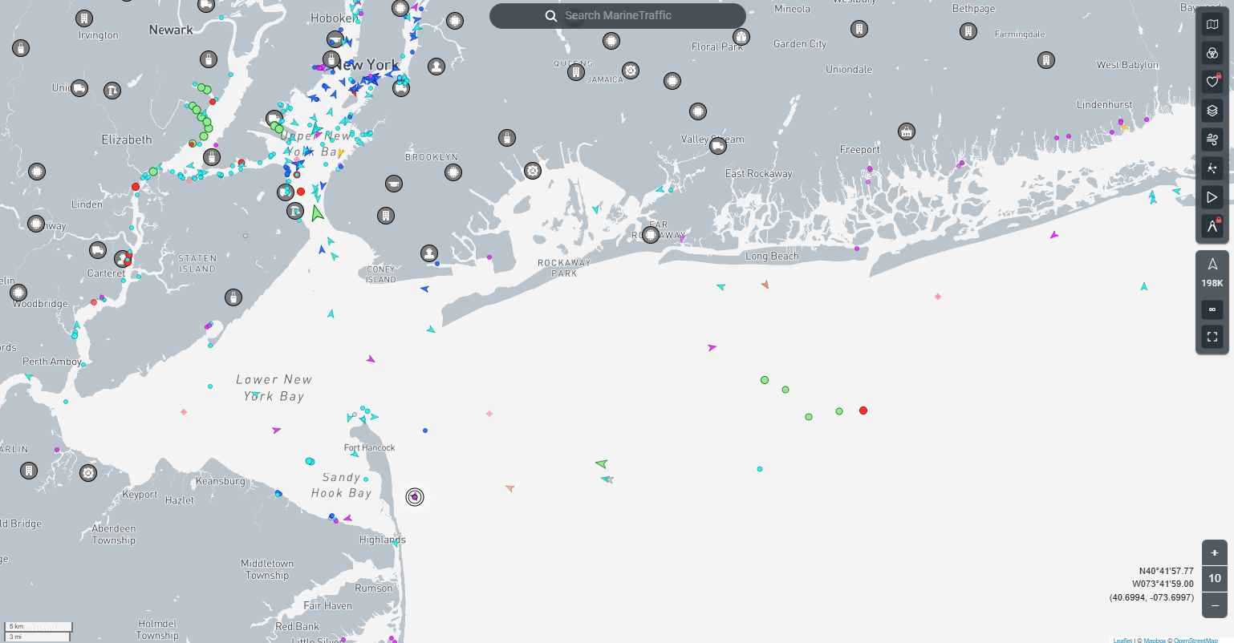

CISC-6100: Software Engineering
Status meetings
Testing
Week 10 -- November 11

Slide 2

Outline for today’s class
Status updates:
Testing
Design patterns
Homework
Time to work on project

Slide 3
Status updates

Slide 4
Status reports from teams:
D
Edamame
F
A short verbal update on how your project is going. Please include:
What you’ve worked on in the past week
Unexpected difficulties and thoughts on mitigation
What’s gone well!
Your progress versus your plan, and any changes made to the plan
Next steps

Slide 5
Testing

Slide 6
Testing
Glossary:
Ground truth: information that is known to be real or true, provided by direct observation and measurement (i.e. empirical evidence) as opposed to information provided by inference. (https://en.wikipedia.org/wiki/Ground_truth)
Black-box testing: a method of software testing that examines the functionality of an application without peering into its internal structures or workings. This method of test can be applied virtually to every level of software testing: unit, integration, system and acceptance. It is sometimes referred to as specification-based testing. (https://en.wikipedia.org/wiki/Black-box_testing)
White-box testing (also known as clear box testing, glass box testing, transparent box testing, and structural testing): a method of software testing that tests internal structures or workings of an application, as opposed to its functionality (i.e. black-box testing). In white-box testing, an internal perspective of the system is used to design test cases. The tester chooses inputs to exercise paths through the code and determine the expected outputs. (https://en.wikipedia.org/wiki/White-box_testing)
Gray-box testing: a combination of white-box testing and black-box testing. The aim of this testing is to search for the defects, if any, due to improper structure or improper usage of applications. (https://en.wikipedia.org/wiki/Gray_box_testing)
Stubs: a piece of code used to stand in for some other programming functionality. A stub may simulate the behavior of existing code (such as a procedure on a remote machine; such methods are often called mocks) or be a temporary substitute for yet-to-be-developed code. (https://en.wikipedia.org/wiki/Method_stub)

Slide 7
Testing
Glossary:
Test driver: the wrapper/mechanism that organizes the tests, runs them, and handles their output. (https://stackoverflow.com/questions/22082382/what-exactly-is-a-test-driver)
Edge case: testing that typically involves input values that require special handling in an algorithm behind a computer program. (https://en.wikipedia.org/wiki/Edge_case)

Slide 8
Testing
What is the Ground Truth for:
Testing a new cypher:
ClearText | encrypt | decrypt | diff ClearText
Testing a Sudoku puzzle solver
Compare results with
known puzzles with solutions
known puzzles and solve by hand
Testing a camera-based pulse detection system
Test against “gold standard”
“Fun” with data mining (True story)
A study of 10,000+ hospital patients using nurse acquired data showed that patients whose heart rate was an odd number were 7x more likely to have an adverse event than those with an even number.
* Data mining was accurate
* Inference is misleading

Slide 9

Testing
Regression testing is a type of software testing that verifies that changes to a program or code do not negatively impact existing features:
When it's performed - Regression testing is performed after various changes, including:
Bug fixes
Software enhancements
Configuration adjustments
Optimizing the source code
How it's performed - Regression testing involves re-running functional and non-functional tests that were originally scripted when known problems were first fixed. This can be done manually on small projects, but in most cases, automated testing tools are required.
Some best practices for regression testing include:
Maintaining an organized test suite
Prioritizing test cases
Automating repetitive tests
Using version control
Practicing effective defect tracking and reporting
Monitoring regression testing metrics
How do we assess if results are correct?
Print statements or the equivalent
Visual inspection using breakpoints
Send to a log file or a spread sheet
Google generative AI (modified)

Slide 10
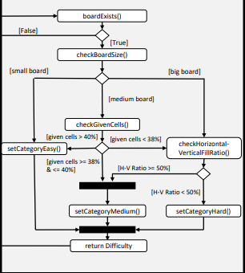
Testing
Unit testing:
Low-level testing. Typically done at the function level or class/method level in object-oriented programming.
Testing of algorithms
Tests written by code developers as they develop code.
Black-box, Gray-box, or White-box testing
Should test against:
Known “good” input
Known “bad” input
Edge cases
def fib(n):
count = 0
c, b = 0, 1
while count < n:
c, b = b, c+b
count = count + 1
return c

Slide 11
Testing
Unit testing:
Low-level testing. Typically done at the function level or class/method level in object-oriented programming.
Testing of algorithms
Tests written by code developers as they develop code.
Black-box, Gray-box, or White-box testing
Should test against:
Known “good” input
Known “bad” input
Edge cases
def average(list):
sum = 0
for item in list:
sum = sum + item
return sum / len(list)
>>> average([10,20,30])
…
>>> average([])
…
>>> average([0])
…

Slide 12
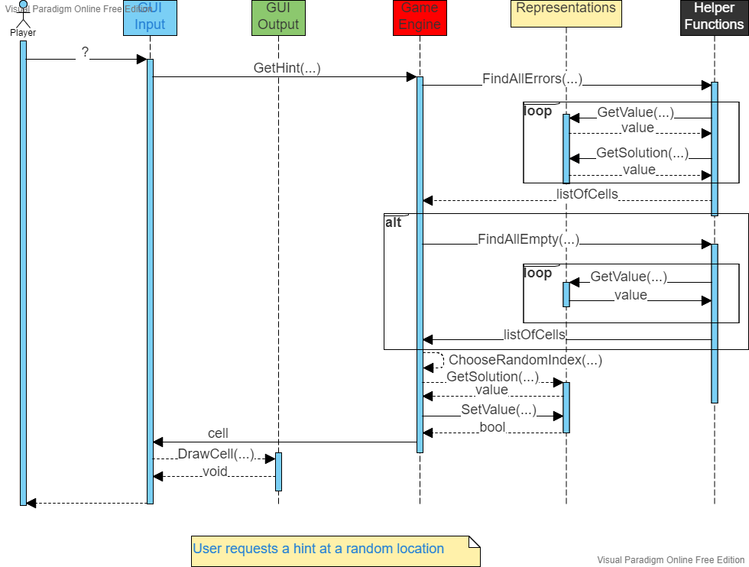
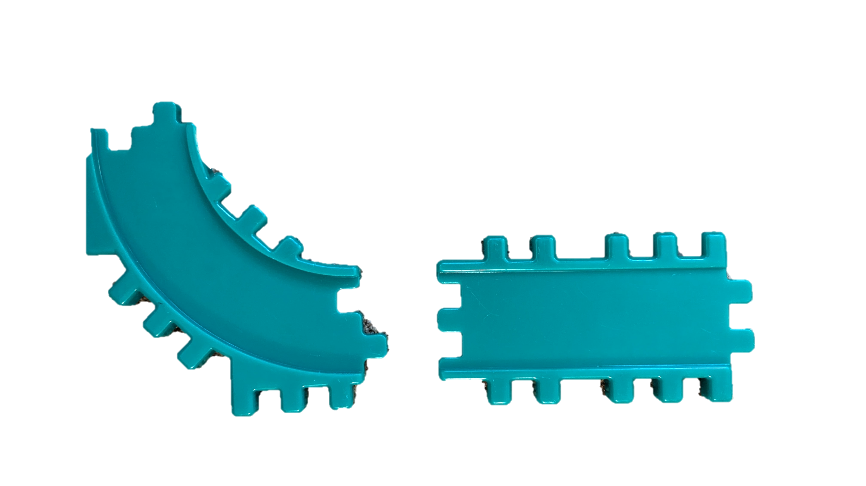
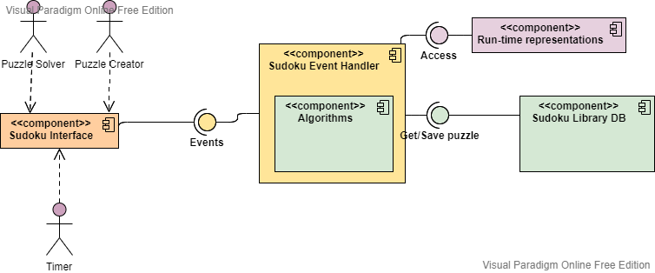
Testing
Integration testing:
Testing interfaces among components
Can be tested before components are completed by use of “stubs”
Progressively done on larger and larger groups of software components
Black-box and/or Gray-box testing

Slide 13
Testing
Example of driver:
public bool TestHintAtRandomLocation(Puzzle puzzle) {
try {
Cell cells[] = Algorithms.FindAllErrors(puzzle);
cells[] = Algorithms.FindAllEmpty(puzzle);
Cell cell = GetCell(1,1);
int sol = cell.GetSolution();
cell.SetValue(sol);
}
catch {
// log error or write message
return false;
}
return true;
}

Slide 14
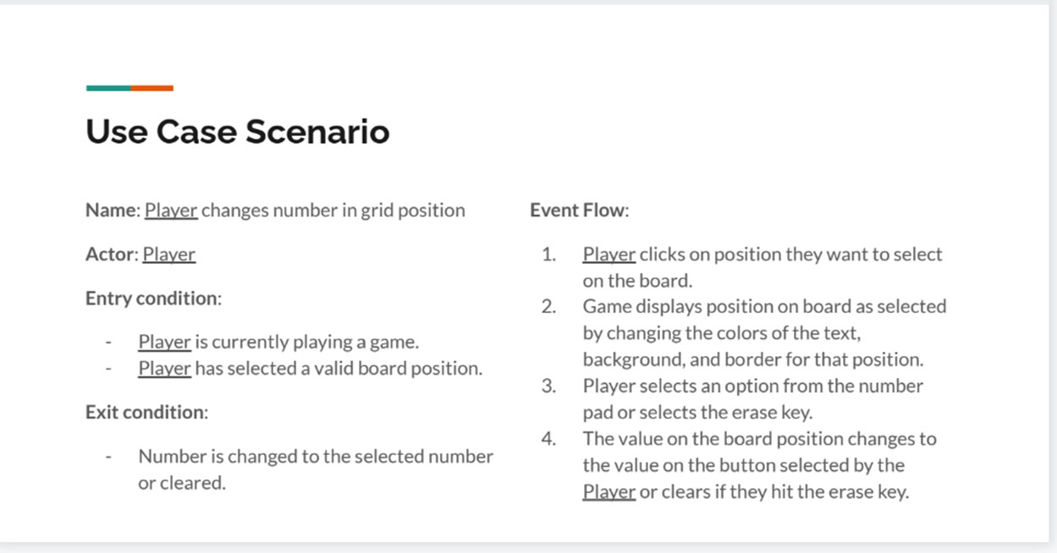
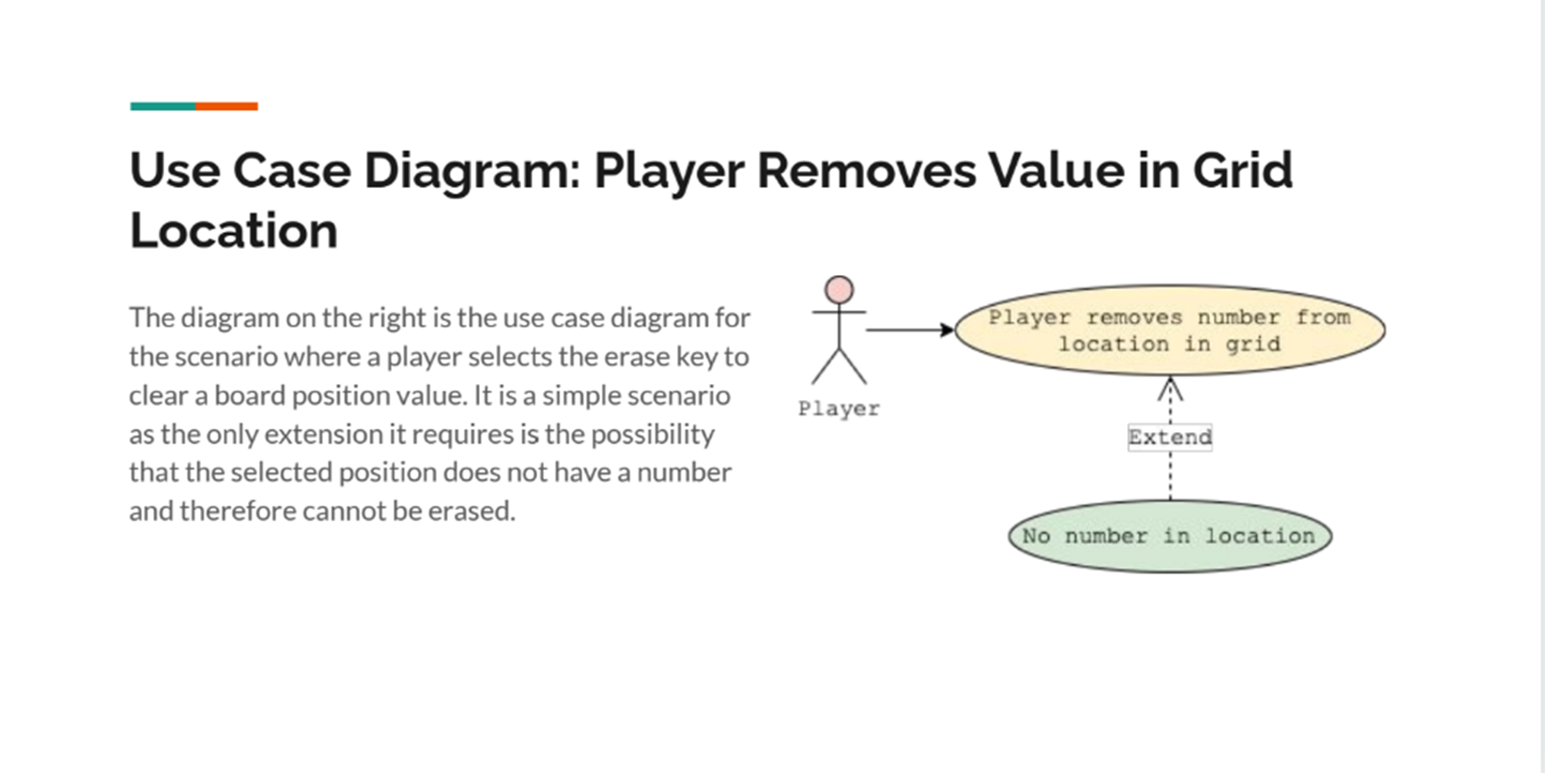
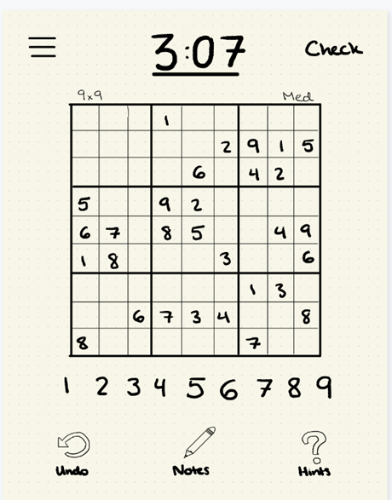
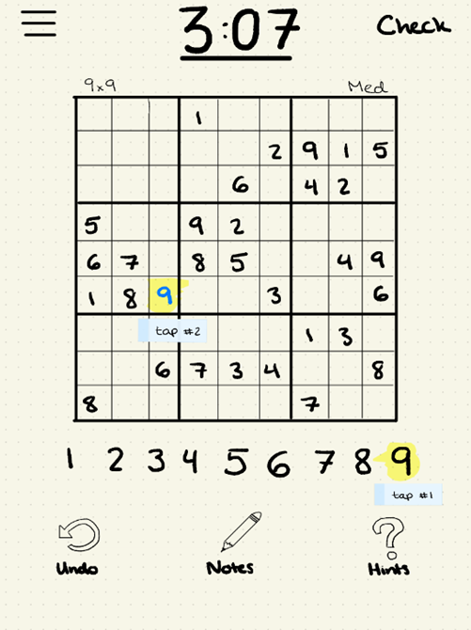
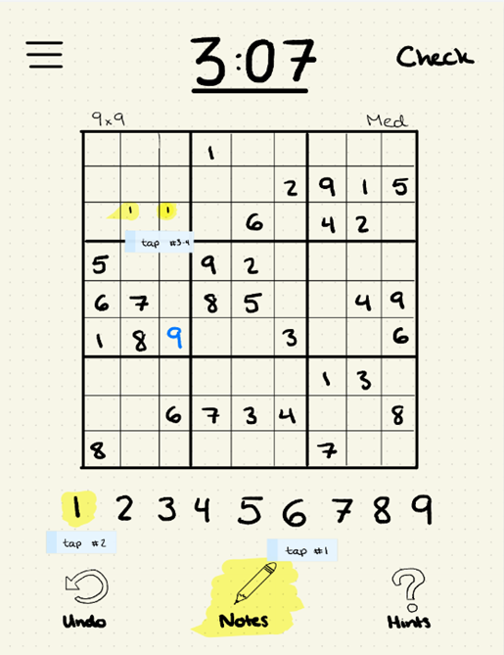
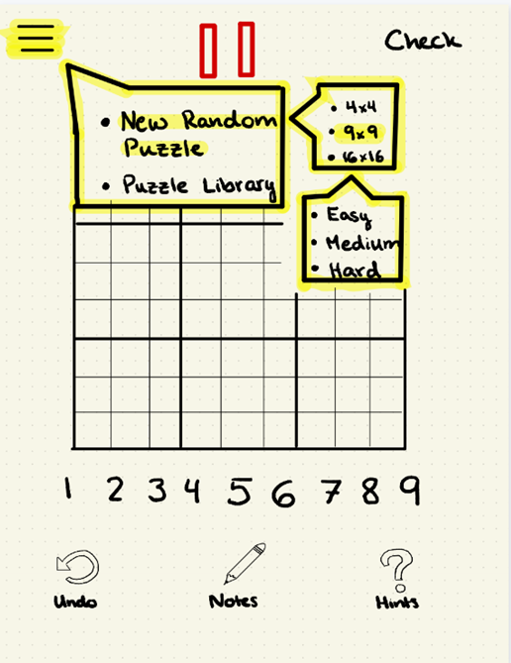
Testing
System testing:
Testing of completed system against its requirements
Black-box and/or Gray-box testing

Slide 15

Testing
Acceptance testing:
User testing
Regulatory testing
Alpha / beta testing

Slide 16
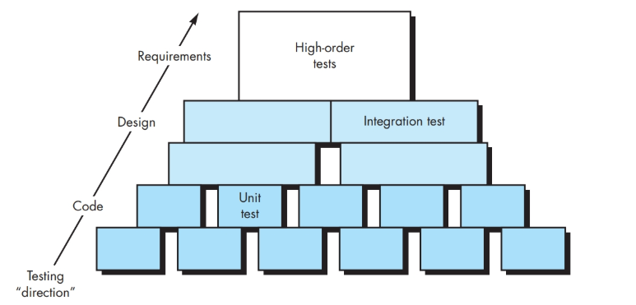
Testing
Test-case design
Types
Levels
Unit
Boundary
Stubs
Integration
Top-down
Depth-first
Breadth-first
Stub out lower levels
Bottom-up
Drivers for upper levels
Regression testing
System
Recovery testing
Security testing
Stress testing
Performance testing
Deployment testing
Test execution
Data collection and evaluation

Slide 17
Junit (example of how to create Drivers for testing when “upper” levels are missing. And much more…)
import org.junit.*;
public class FoobarTest {
@BeforeClass
public static void setUpClass() throws Exception {
// Code executed before the first test method
}
@Before
public void setUp() throws Exception {
// Code executed before each test
}
@Test
public void testOneThing() {
// Code that tests one thing
}
@Test
public void testAnotherThing() {
// Code that tests another thing
}
@Test
public void testAnotherThing() {
// Code that tests another thing
}
@Test
public void testSomethingElse() {
// Code that tests something else
}
@After
public void tearDown() throws Exception {
// Code executed after each test
}
@AfterClass
public static void tearDownClass() throws Exception {
// Code executed after the last test method
}
}
Test results can be written to the console, a file, or even a spreadsheet
A research survey performed in 2013 across 10,000 Java projects hosted on GitHub found that JUnit (in a tie with slf4j-api), was the most commonly included external library. Each library was used by 30.7% of projects
From: https://en.wikipedia.org/wiki/JUnit

Slide 18
More on testing
Python Example
def DiabolicalGame():
return [
[
[[0,0,4], [0,2,0], [6,0,0]],
[[5,0,1], [0,8,0], [0,0,0]],
[[9,0,0], [0,3,0], [0,0,5]]],
[[[0,0,8], [0,5,0], [0,0,3]],
[[7,0,6], [0,0,0], [4,0,8]],
[[3,0,0], [0,9,0], [5,0,0]]],
[[[3,0,0], [0,8,0], [0,0,2]],
[[0,0,0], [0,7,0], [8,0,5]],
[[0,0,9], [0,6,0], [1,0,0]]
]]
g = DiabolicalGame()
Stub used to set up use of a driver

Slide 19
More on testing
Python Example
def SolveBruteForce(game):
for boxRow in range(3):
for boxCol in range(3):
for valRow in range(3):
for valCol in range(3):
if game[boxRow][boxCol][valRow][valCol] == 0:
for val in range(1,10):
game[boxRow][boxCol][valRow][valCol] = val
#if CheckVal(game, boxRow, boxCol, valRow, valCol):
if True:
if (boxRow==2) and (boxCol==2) and (valRow==2) and (valCol==2):
return True
if SolveBruteForce(game) == True:
return True
game[boxRow][boxCol][valRow][valCol] = 0
return False
return True
Stub

Slide 20
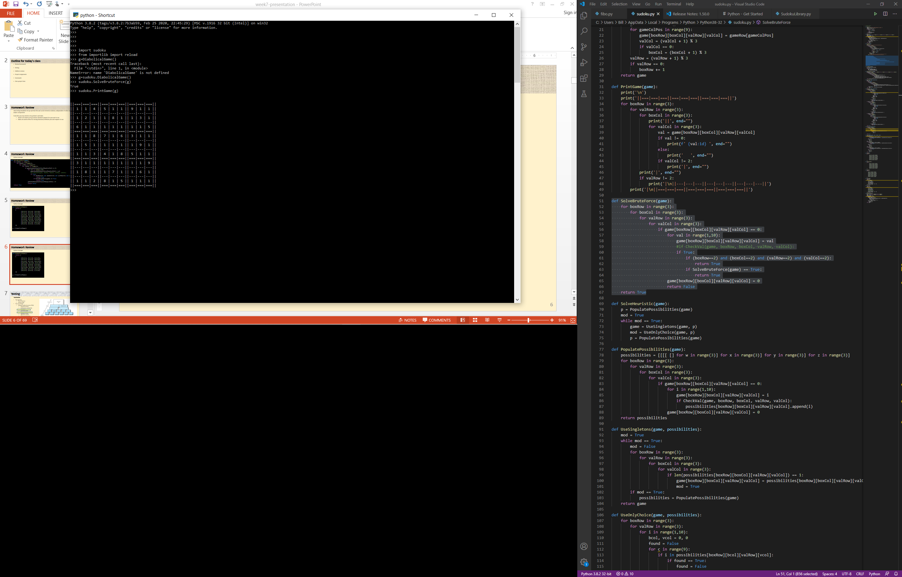
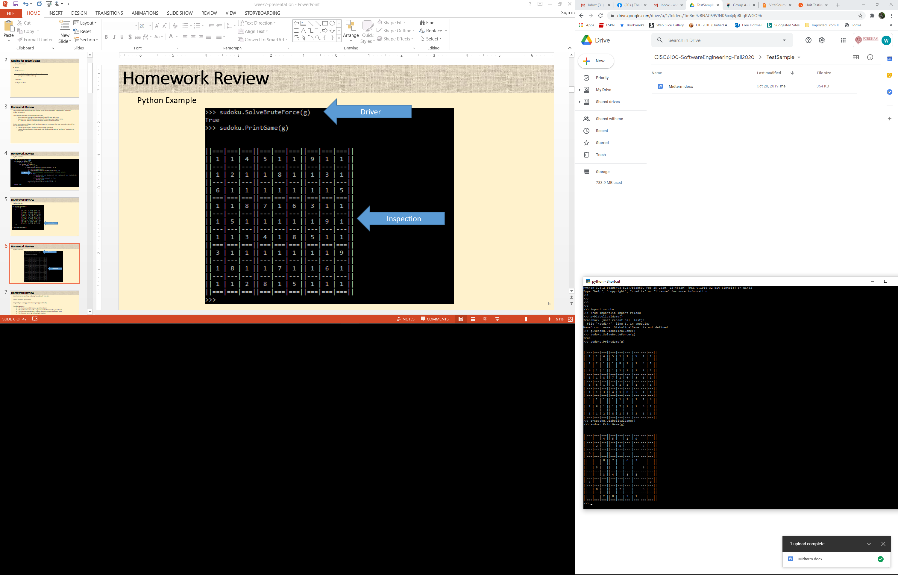
More on testing
Driver
Inspection

Slide 21
Testing
Testing gone too far?
Where should it be tested?
GUI
GetHint(col, row)
Control
GetHint(col, row)
Representation
GetKey(col, row)
col<9
row<9
col<9
row<9
col<9
row<9

Slide 22
Testing
Input validation
GUI
Algorithms and storage
Database
Expert System
0<=HR<=300
SBP>=DBP
…
Comparison to norms

Slide 23
Testing
Input validation
GUI
Algorithms and storage
Database
Expert System
Comparison to other inputs
0<=HR_{ECG}<=300
HR_{ECG} = HR_{SPO2} (+/-10)

Slide 24
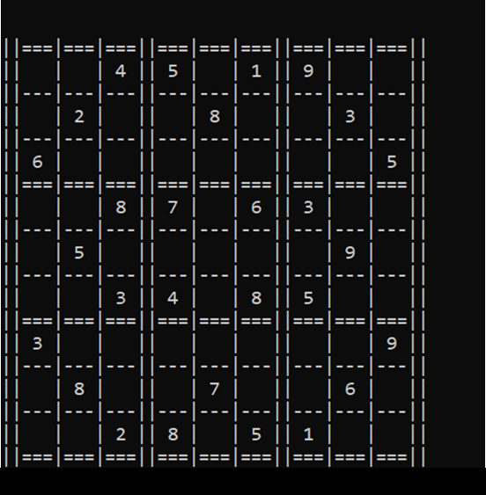
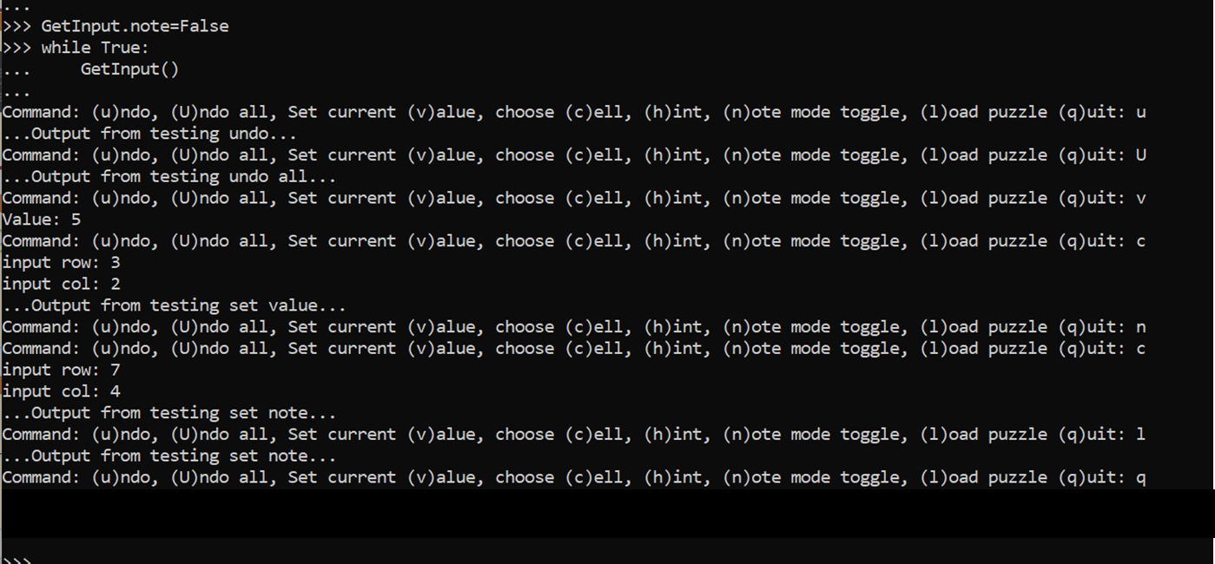
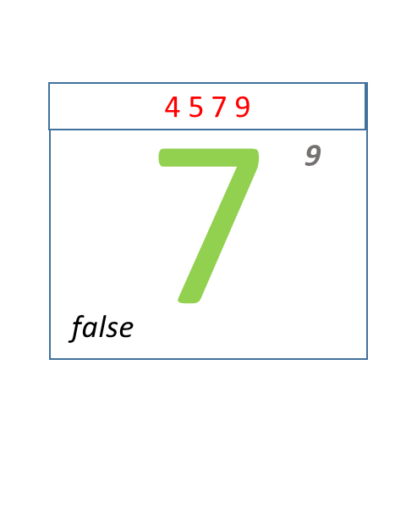
Project
Example of a stub to show output
Example output of a driver to test overall system

Slide 25
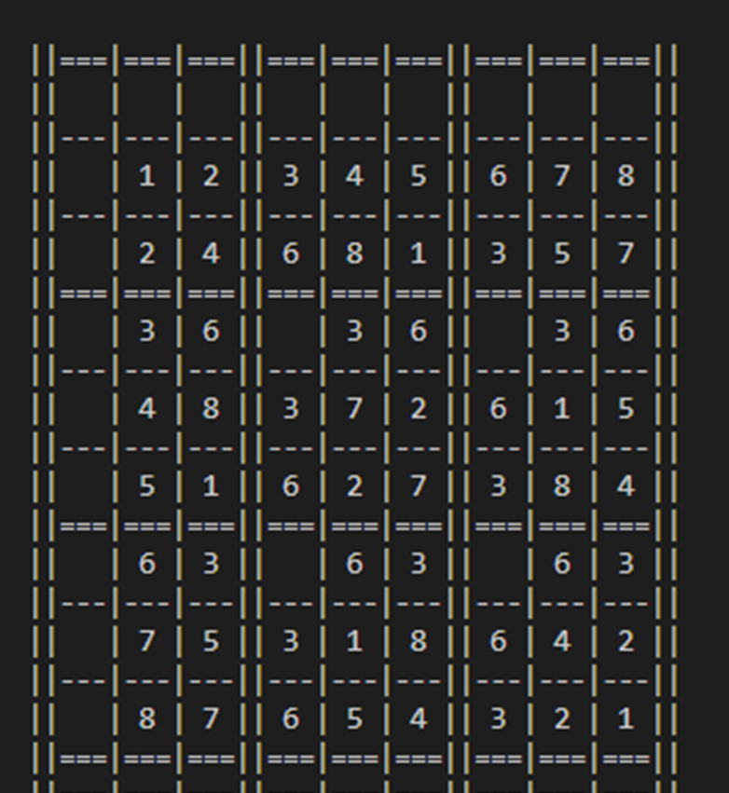
Unit testing
# def PrintGame(game):
def PrintGame():
print('\n')
print('||===|===|===||===|===|===||===|===|===||')
for row in range(9):
for col in range(9):
#val = game.GetCell(row,col).GetValue()
val = (row * col) % 9
if (col == 0) or (col == 3) or (col == 6):
print('||', end="")
if val != 0:
print(f' {val:1d} ', end="")
else:
print(' ', end="")
else:
print('|', end="")
if val != 0:
print(f' {val:1d} ', end="")
else:
print(' ', end="")
if col == 8:
print('||')
if (row == 2) or (row == 5):
print('||===|===|===||===|===|===||===|===|===||')
else:
if (row != 8):
print('||---|---|---||---|---|---||---|---|---||')
print('||===|===|===||===|===|===||===|===|===||')
Easy case –
Write program as if integration was possible
Comment out all code that requires integration
Replace with code that returns something like the integrated code would return

Slide 26
Unit testing
class History:
def __init__(self):
self.stack = []
def PushHistory(self, value):
return self.stack.append(value)
def PopHistory(self):
return self.stack.pop(-1)
def CheckForEmpty(self):
if len(self.stack) != 0: return False
return True
history = History()
history.PushHistory(5)
history.PushHistory(6)
history.PushHistory(7)
while history.CheckForEmpty() == False:
value = history.PopHistory()
print(value)
history.PushHistory([1,2,3])
history.PushHistory([4,5,6])
history.PushHistory([7,8,9])
while history.CheckForEmpty() == False:
value = history.PopHistory()
print(value)
-----------------------------------------------
7
6
5
[7, 8, 9]
[4, 5, 6]
[1, 2, 3]
Super easy case in Python –
Because Python is not a strongly typed language, test with simple parameters
Note that CheckForEmpty() had to be added to the original definition of History (in the class diagram)

Slide 27
Unit testing
class History:
def __init__(self):
self.stack = []
def PushHistory(self, value):
return self.stack.append(value)
def PopHistory(self):
return self.stack.pop(-1)
def CheckForEmpty(self):
if len(self.stack) != 0: return False
return True
class Entry:
def __init__(self, orig, new, correct):
self.origCell = orig
self.newCell = new
self.isCorrect = correct
def GetOrigCell(self):
return self.origCell
def GetNewCell(self):
return self.newCell
def IsCorrect(self):
return self.isCorrect
class Cell:
def __init__(self):
self.value = 0
self.row = -1
self.col = -1
def GetValue(self):
return self.value
def SetValue(self, val):
self.value = val
def GetRow(self):
return self.row
def SetRow(self, row):
self.row = row
def GetCol(self):
return self.col
def SetCol(self, col):
self.col = col
Only slightly less than easy–
Approach works in Python and C++
Full implementation of History and Entry, with a minimal implementation of Cell (stub) and Puzzle (not shown…yet)
oldCell = Cell()
oldCell.SetRow(8)
oldCell.SetCol(8)
oldCell.SetValue(4)
newCell = Cell()
newCell.SetValue(6)
newCell.SetRow(8)
newCell.SetCol(8)
puzzle.SetCell(newCell)
entry = Entry(oldCell, newCell, True)
history.PushHistory(entry)
...

Slide 28
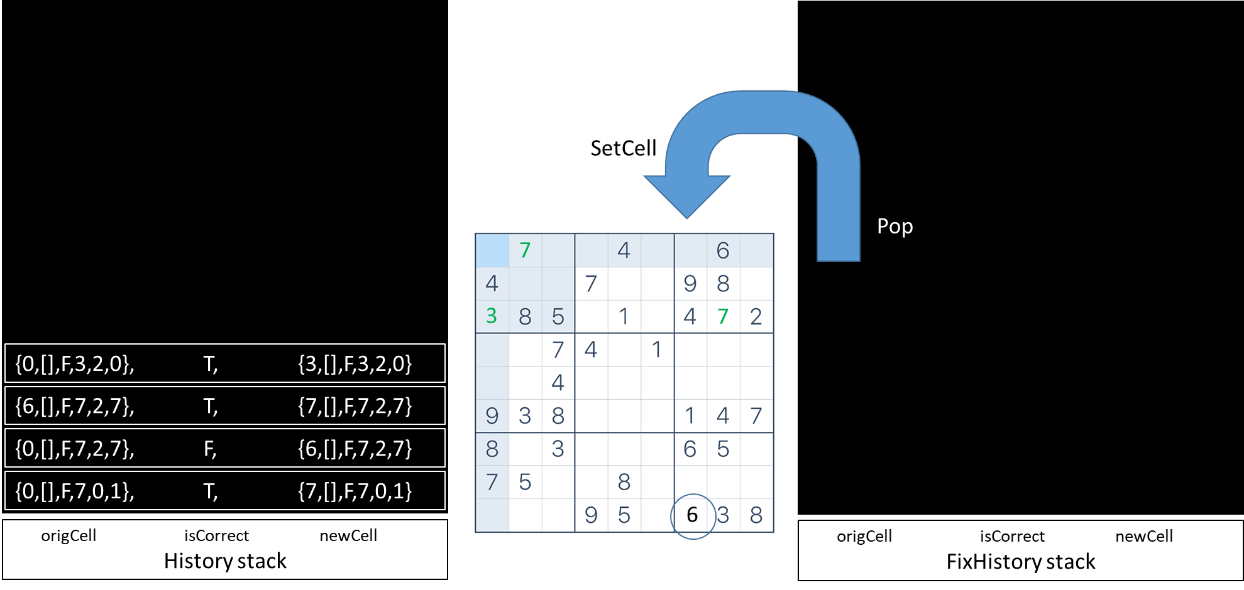
Unit testing
Difficult to unit test –
Almost all lines of code require integration
Could write minimal functionality for missing classes, methods, and functions
Could also use paper and pencil to create puzzle board, representation of a stack, and then trace various scenarios through the code to see if it meets expectations.
void GameEngine::UndoUntilCorrect() {
while (!history->CheckForEmpty()) {
Entry* entry = history->PopHistory();
if (entry->IsCorrect()) {
history->PushHistory(entry);
return;
}
Cell* cell = entry->GetOrigCell();
int row = cell->GetRow();
int col = cell->GetCol();
Cell* puzzleCell = puzzle->GetCell(row, col);
puzzleCell->SetValue(cell->GetValue());
for (int i = 0; i < 9; i++) {
puzzleCell->GetNotes()[i] = cell->GetNotes()[i];
}
}
}

Slide 29
Integration testing
Manually
Use above tools in an interactive manner
Easy to direct tests to specific concerns
Can become very time consuming to test all aspects of system after any code modifications
Automated
Takes a long time to set up
Easily repeatable after any code modifications
Can help with progress tracking
Lot less time spent in the long run
Create ways to setup system for testing:
Load/initialize puzzles
Triggering various paths
Providing input
Create ways to display modified information result
Print puzzle values
Print puzzle notes
(Display in debugger)

Slide 30
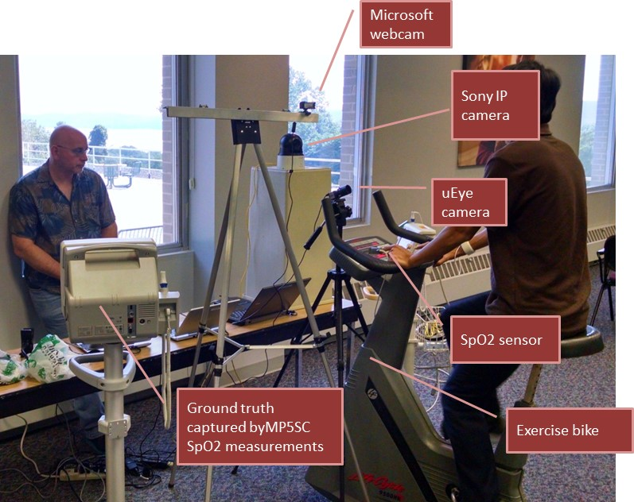
Actual example: performance testing
Hardware
Software
Short tangent… (Roles of a SW engineer)
Quick look at the many tasks of Software Engineers though the lens of an actual project:
Started with a technology without an application
Learning of needs in the industry
Acquiring domain knowledge (clinical)
Acquiring domain knowledge (business)
Study potential technology-based solutions and non-technological solutions
Develop a business case
Storyboard
Prototype key components
Testing - IRB
Applying for grants

Slide 31
For each of the following describe how you might design the testing to be run before final release:
Azerbaijan: Video game –
Bro: Bank’s money transfer app –
C: SpaceX re-entry code –
D: Sudoku puzzle solver –
Edamame: Tax return software (e.g. TurboTax) -
F: Eye tracking eReader -

Slide 32
For each of the following describe how you might design the testing to be run before final release:
Video game – As this is not critical (relatively speaking) you could start with internal testing by employees and their families, and then when more mature start beta testing with select customers.
Bank’s money transfer app – This is more critical, field testing is not an option. Set up internal testing with fake accounts. Test bi-directionally, to/from all types of accounts (checking, savings, money market); test with small amounts, large amounts, high-precision amounts, negative amounts; test where currency exchange would be required; test for any involved fees.
SpaceX re-entry code – Life critical, “failure is not an option.” Set up extensive modelling environment and test in the model.
Sudoku puzzle solver – Create test suite from the 1000s of readily available games. Run solution on the test suite. Fix any bugs and repeat testing until no more bugs detected. (Regression testing)
Tax return software (e.g. TurboTax) - Hire a tax expert (e.g. CPA) to validate results of test run on a large collection of example tax returns. Use someone who knows nothing about tax returns to test usability, and handling of illegal data entry.
Eye tracking eReader – User testing with tracking of:
True Positives
True Negatives
False Positives
False Negatives

Slide 33
Performance testing – How well does the system perform: Testing of:
Inferences
Assumptions
Tuning
True Positives – The number of positive responses
The number of times looking into the right margin caused a page turn
True Negatives – The number of times there was, as expected, no response to a given situation
The number of lines completely read without an unexpected action
False Positives – The number of times there was an unexpected action
The number of times an action was taken while a line was being read
False Negatives – The number of times an action was expected and none happened
The number of times getting to the end of a line did not cause a page turn

Slide 34
Condition
+
-
+
True Positive
False Positive
Sensitivity – A measure of how often a desired situation is detected
Sensitivity = True Positives / (True Positives + False Negatives)
Specificity – A measure of how accurately the desired situation is detected
Specificity = True Negatives / (True Negatives + False Positives)
Result
-
False Negative
True Negative

Slide 35
Performance testing – How well does the system perform: Testing of:
ROC curve –Receiver operating characteristic curve
AUC – Area under curve
100%
ROC curve
By tuning your program/system/formula you can plot the resulting sensitivity versus specificity to find the “best” combination for your particular situation.
AUC
True positive rate (sensitivity)%
Random chance
0,0
False positive rate (1 – specificity)%
100%

Slide 36
Design patterns

Slide 37
Design Patterns
Material presented is in part from:
https://en.wikipedia.org/wiki/Software_design_pattern
https://cs.brown.edu/cgc/jdsl/papers/patterns.pdf

Slide 38
A design pattern is:
General, reusable approach to a commonly occurring problem
A description for how to solve a problem that can be used in many different situations
Formalized best practices to use for common problems
A design pattern is not:
A finished design that can be transformed directly into source code
Four general ways to group design patterns are:
Creational Patterns
Structural Patterns
Behavioral Patterns
Concurrency Patterns
However there are many domain specific design patterns:
User interfaces
Information visualization
Secure design
Secure usability
Web design
Business model design

Slide 39
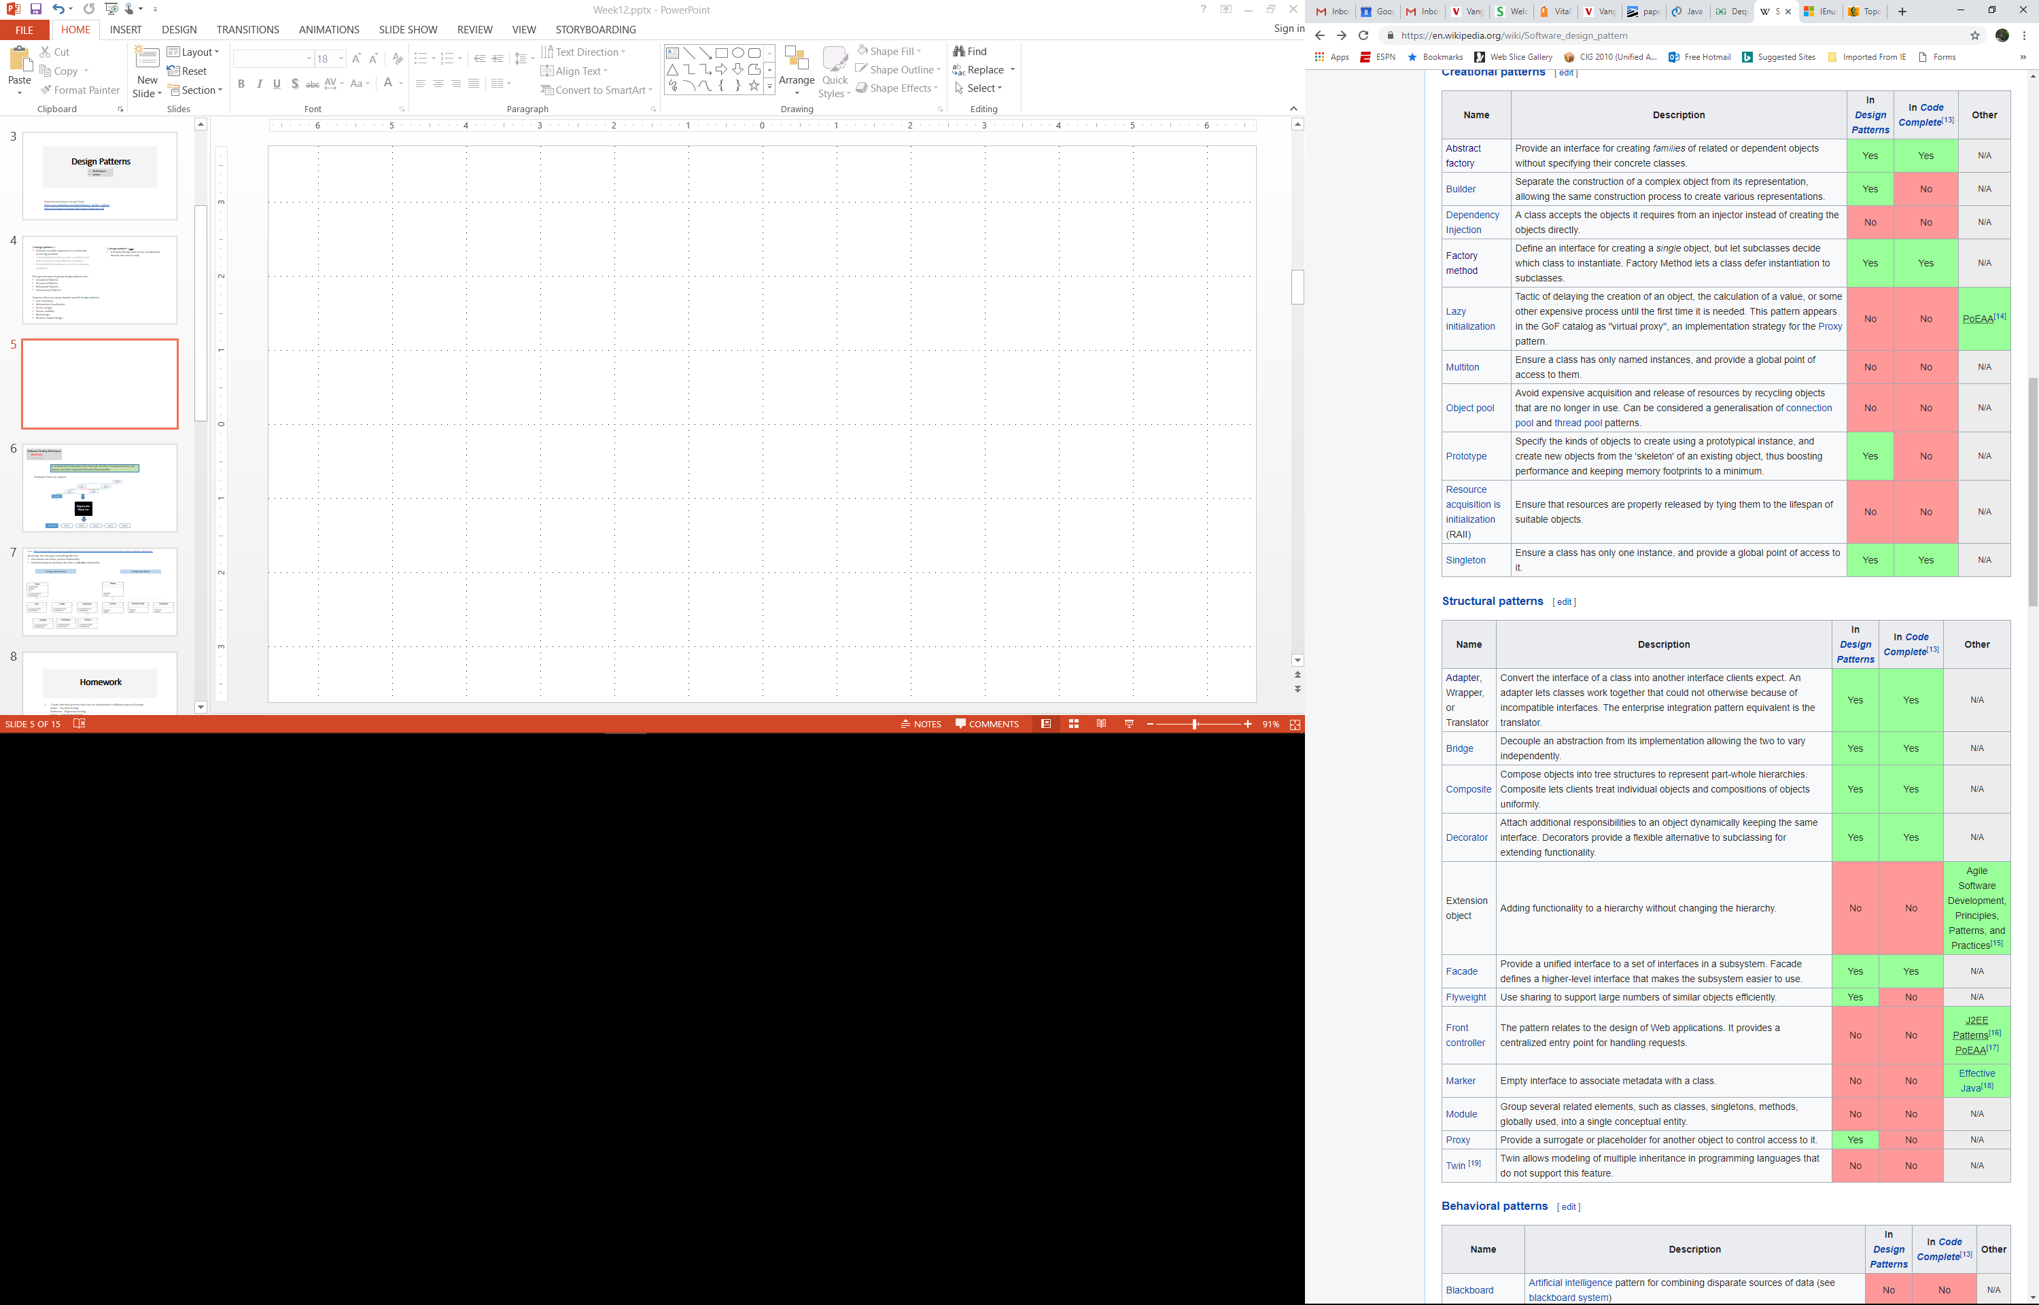
In-depth use of Wikipedia for studying design patterns reveals a weakness in its construction: following links to each design pattern shows lack of uniformity in presentation of a design pattern.

Slide 40
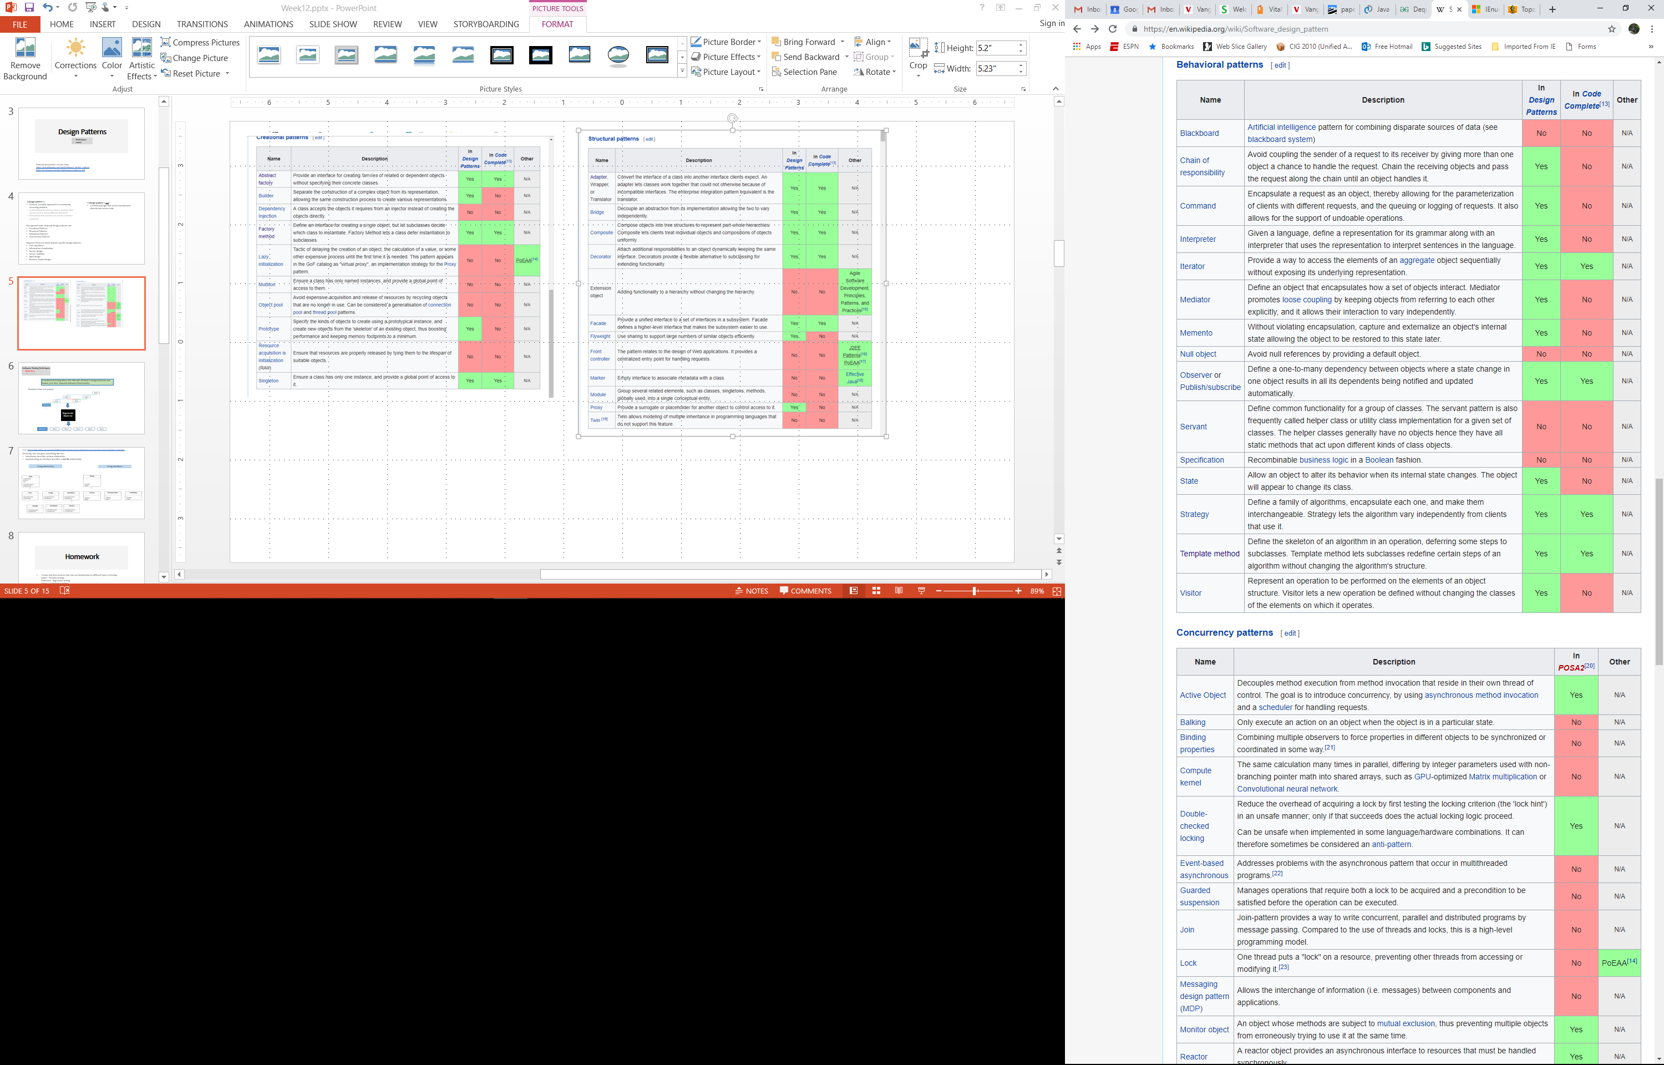

Slide 41
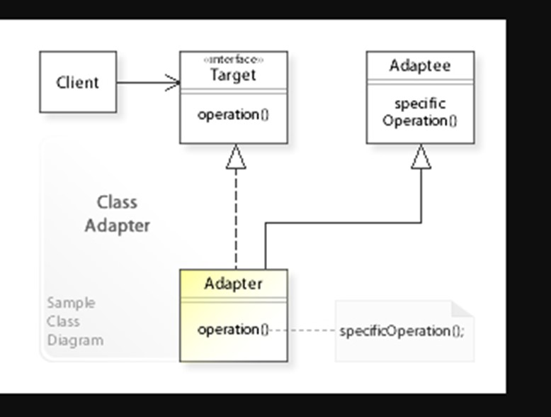
Selected Design Pattern Examples: Adapter
Allows the interface of an existing class to be used as (via) another interface. It is often used to make existing classes work with others without modifying their source code.
Client
<<interface>>
Temperature
getTemp()
Celsius
getTheTemp()…
Fahrenheit
getTemp()…
convertCtoF()
https://commons.wikimedia.org/wiki/File:W3sDesign_Adapter_Design_Pattern_UML.jpg#/media/File:W3sDesign_Adapter_Design_Pattern_UML.jpg

Slide 42
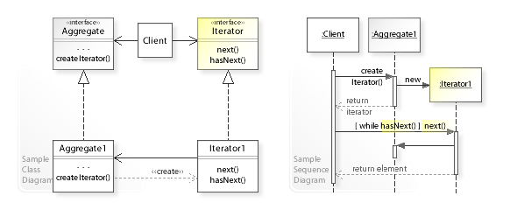
Selected Design Pattern Examples: Iterator
In object-oriented programming, the iterator pattern is a design pattern in which an iterator is used to traverse a container and access the container's elements. The iterator pattern decouples algorithms from containers.
UML diagrams are frequently used in explanatory/instructive texts of design patterns.

Slide 43
Some built in enumerables that you can iterate over in C#:
String
List
Array
All enumerable types can be iterated over with the foreach statement:
foreach (char c in MyString)
{
//Do some action
}
foreach (object o in ObjectList)
{
//Do some action
}
foreach (int i in IntArray)
{
//Do some action
}

Slide 44
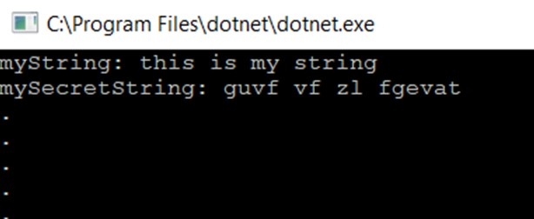
Selected Design Pattern Examples: Iterator
Examples of native iterator: C# example
string myString = "this is my string";
string mySecretString = new string("");
foreach (char c in myString)
{
if (c != ' ')
mySecretString += ((char)((c - 'a' + 13) % 26 + 'a')).ToString();
else
mySecretString += ' ';
}
Console.WriteLine("myString: " + myString);
Console.WriteLine("mySecretString: " + mySecretString);

Slide 45
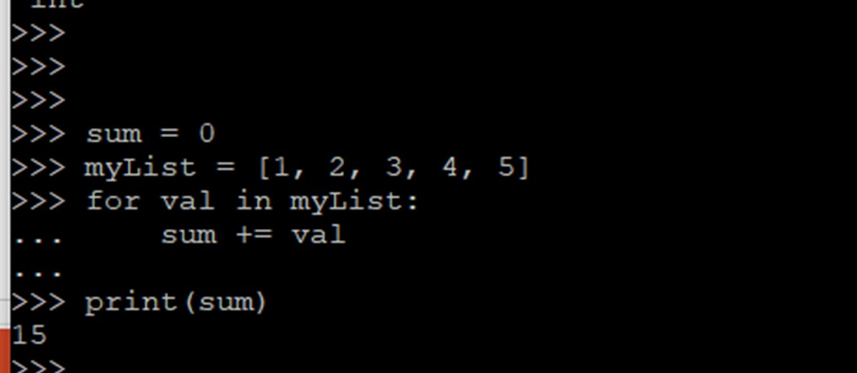
Selected Design Pattern Examples: Iterator
Examples of native iterator – Python example

Slide 46
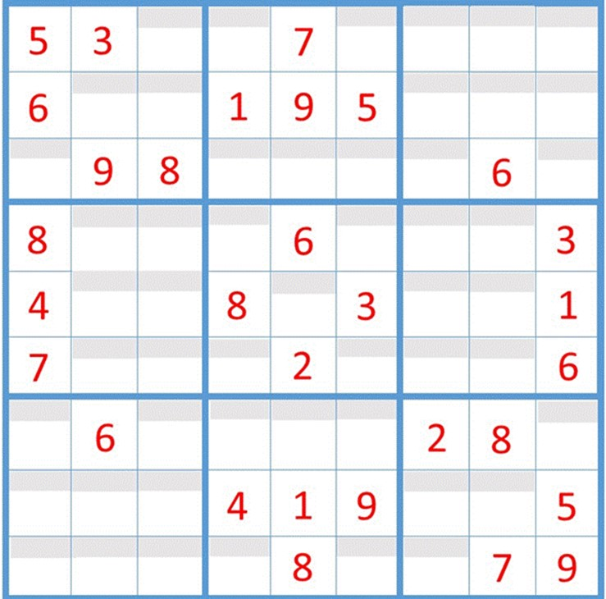
for(int i=0; i<board.GetLength(0); i++)
{
for(int j=0; j<board.GetLength(1); j++)
{
// Perform some function… For example:
// Find all “hardwired” tiles
// Find all empty tiles
// Find all notes
}
}
foreach (Cell cell in puzzle)
{
// Perform some function… For example:
// Find all “hardwired” cells
// Find all empty cells
// Find all notes
}

Slide 47
Selected Design Pattern Examples: Iterator
foreach
Array[index]
Matrix
Array

Slide 48
Selected Design Pattern Examples: Iterator
public class Puzzle : IEnumerable
{
…
IEnumerator IEnumerable.GetEnumerator()
{
return (IEnumerator) new PuzzleEnum(board);
}
public PuzzleEnum GetEnumerator()
{
return new PuzzleEnum(board);
}
}

Slide 49
public class PuzzleEnum : IEnumerator
{
private List<int> vals = new List<int>();
private int[] valArray;
private int position = -1;
public PuzzleEnum(int [,] board)
{
for(int i=0; i<board.GetLength(0); i++)
{
for(int j=0; j<board.GetLength(1); j++)
{
vals.Add(board[i, j]);
}
}
valArray = vals.ToArray();
}
object IEnumerator.Current
{
get
{
return Current;
}
}
public int Current
{
get
{
try
{
return valArray[position];
}
catch (IndexOutOfRangeException)
{
throw new InvalidOperationException();
}
}
}
public bool MoveNext()
{
position++;
return (position < valArray.Length);
}
public void Reset()
{
position = -1;
}
}
}
Note that one team member still has to implement the iterator, but then all team members can reap the benefits.

Slide 50
Leftovers: Iterator design pattern
Passing a function as a parameter
bool LoopOverPuzzle(Puzzle* puzzle, void (*func)(Puzzle*, int, int, bool*))
{
bool b;
for (int r = 0; r < 9; r++) {
for (int c = 0; c < 9; c++) {
func(puzzle, r, c, &b);
}
}
return b;
}

Slide 51
Leftovers: Iterator design pattern
Passing a function as a parameter
// Load test game
LoopOverPuzzle(&puzzle, &LoadGame);
// Pretty print the puzzle
std::cout << "\n";
std::cout << "||===|===|===||===|===|===||===|===|===||\n";
LoopOverPuzzle(&puzzle, &PrintGame);
std::cout << "||===|===|===||===|===|===||===|===|===||\n";
// Solve the puzzle
SolveBruteForce(&puzzle);
// Pretty print the soluton
std::cout << "\n";
std::cout << "||===|===|===||===|===|===||===|===|===||\n";
LoopOverPuzzle(&puzzle, &PrintSolution);
std::cout << "||===|===|===||===|===|===||===|===|===||\n";

Slide 52
Leftovers: Iterator design pattern
Passing LoadGame as a parameter
int EvilPuzzle[] = { 0,0,4, 5,0,1, 9,0,0,
0,2,0, 0,8,0, 0,3,0,
6,0,0, 0,0,0, 0,0,5,
0,0,8, 7,0,6, 3,0,0,
0,5,0, 0,0,0, 0,9,0,
0,0,3, 4,0,8, 5,0,0,
3,0,0, 0,0,0, 0,0,9,
0,8,0, 0,7,0, 0,6,0,
0,0,2, 8,0,5, 1,0,0 };
// Load test game
LoopOverPuzzle(&puzzle, &LoadGame);
void LoadGame(Puzzle * puzzle, int r, int c, bool *b)
{
Cell cell;
cell.SetRow(r);
cell.SetCol(c);
cell.SetValue(EvilPuzzle[r * 9 + c]);
if (cell.GetValue() != 0) {
cell.SetHardWired(true);
cell.SetSolution(cell.GetValue());
}
else {
cell.SetSolution(0);
cell.SetHardWired(false);
}
for (int i = 0; i < 9; i++) {
cell.GetNotes()[i] = 0;
}
puzzle->SetCell(cell);
return;
}
bool LoopOverPuzzle(Puzzle* puzzle, void (*func)(Puzzle*, int, int, bool*))
{
bool b;
for (int r = 0; r < 9; r++) {
for (int c = 0; c < 9; c++) {
func(puzzle, r, c, &b);
}
}
return b;
}

Slide 53
Leftovers: Iterator design pattern
Passing PrintGame as a parameter
||===|===|===||===|===|===||===|===|===||
|| | | 4 || 5 | | 1 || 9 | | ||
||---|---|---||---|---|---||---|---|---||
|| | 2 | || | 8 | || | 3 | ||
||---|---|---||---|---|---||---|---|---||
|| 6 | | || | | || | | 5 ||
||===|===|===||===|===|===||===|===|===||
|| | | 8 || 7 | | 6 || 3 | | ||
||---|---|---||---|---|---||---|---|---||
|| | 5 | || | | || | 9 | ||
||---|---|---||---|---|---||---|---|---||
|| | | 3 || 4 | | 8 || 5 | | ||
||===|===|===||===|===|===||===|===|===||
|| 3 | | || | | || | | 9 ||
||---|---|---||---|---|---||---|---|---||
|| | 8 | || | 7 | || | 6 | ||
||---|---|---||---|---|---||---|---|---||
|| | | 2 || 8 | | 5 || 1 | | ||
||===|===|===||===|===|===||===|===|===||
// Pretty print the puzzle
std::cout << "\n";
std::cout << "||===|===|===||===|===|===||===|===|===||\n";
LoopOverPuzzle(&puzzle, &PrintGame);
std::cout << "||===|===|===||===|===|===||===|===|===||\n";
void PrintGame(Puzzle * puzzle, int r, int c, bool * b) {
int v = puzzle->GetCell(r, c)->GetValue();
if ((c == 0) || (c == 3) || (c == 6)) {
std::cout << "||";
if (v != 0) std::cout << ' ' << v << ' ';
else std::cout << " ";
}
else {
std::cout << "|";
if (v != 0) std::cout << ' ' << v << ' ';
else std::cout << " ";
}
if (c == 8) {
std::cout << "||\n";
if ((r == 2) || (r == 5)) std::cout << "||===|===|===||===|===|===||===|===|===||\n";
else if (r != 8) std::cout << "||---|---|---||---|---|---||---|---|---||\n";
}
return;
}
bool LoopOverPuzzle(Puzzle* puzzle, void (*func)(Puzzle*, int, int, bool*))
{
bool b;
for (int r = 0; r < 9; r++) {
for (int c = 0; c < 9; c++) {
func(puzzle, r, c, &b);
}
}
return b;
}

Slide 54
Leftovers: Iterator design pattern
Passing PrintSolution as a parameter
||===|===|===||===|===|===||===|===|===||
|| 8 | 3 | 4 || 5 | 6 | 1 || 9 | 2 | 7 ||
||---|---|---||---|---|---||---|---|---||
|| 7 | 2 | 5 || 9 | 8 | 4 || 6 | 3 | 1 ||
||---|---|---||---|---|---||---|---|---||
|| 6 | 1 | 9 || 2 | 3 | 7 || 4 | 8 | 5 ||
||===|===|===||===|===|===||===|===|===||
|| 1 | 9 | 8 || 7 | 5 | 6 || 3 | 4 | 2 ||
||---|---|---||---|---|---||---|---|---||
|| 4 | 5 | 6 || 1 | 2 | 3 || 7 | 9 | 8 ||
||---|---|---||---|---|---||---|---|---||
|| 2 | 7 | 3 || 4 | 9 | 8 || 5 | 1 | 6 ||
||===|===|===||===|===|===||===|===|===||
|| 3 | 4 | 7 || 6 | 1 | 2 || 8 | 5 | 9 ||
||---|---|---||---|---|---||---|---|---||
|| 5 | 8 | 1 || 3 | 7 | 9 || 2 | 6 | 4 ||
||---|---|---||---|---|---||---|---|---||
|| 9 | 6 | 2 || 8 | 4 | 5 || 1 | 7 | 3 ||
||===|===|===||===|===|===||===|===|===||
// Pretty print the puzzle
std::cout << "\n";
std::cout << "||===|===|===||===|===|===||===|===|===||\n";
LoopOverPuzzle(&puzzle, &PrintSolution);
std::cout << "||===|===|===||===|===|===||===|===|===||\n";
void PrintSolution(Puzzle * puzzle, int r, int c, bool * b) {
int v = puzzle->GetCell(r, c)->GetSolution();
if ((c == 0) || (c == 3) || (c == 6)) {
std::cout << "||";
if (v != 0) std::cout << ' ' << v << ' ';
else std::cout << " ";
}
else {
std::cout << "|";
if (v != 0) std::cout << ' ' << v << ' ';
else std::cout << " ";
}
if (c == 8) {
std::cout << "||\n";
if ((r == 2) || (r == 5)) std::cout << "||===|===|===||===|===|===||===|===|===||\n";
else if (r != 8) std::cout << "||---|---|---||---|---|---||---|---|---||\n";
}
return;
}
bool LoopOverPuzzle(Puzzle* puzzle, void (*func)(Puzzle*, int, int, bool*))
{
bool b;
for (int r = 0; r < 9; r++) {
for (int c = 0; c < 9; c++) {
func(puzzle, r, c, &b);
}
}
return b;
}

Slide 55
Leftovers: Iterator design pattern
Passing SolveBruteForce and CheckPuzzle as a parameter
bool LoopOverPuzzle(Puzzle* puzzle, void (*func)(Puzzle*, int, int, bool*))
{
bool b;
for (int r = 0; r < 9; r++) {
for (int c = 0; c < 9; c++) {
func(puzzle, r, c, &b);
}
}
return b;
}
bool SolveBruteForce(Puzzle* puzzle) {
for (int row = 0; row < 9; row++) {
for (int col = 0; col < 9; col++) {
Cell* cell;
cell = puzzle->GetCell(row, col);
if (cell->GetSolution() == 0) {
for (int val = 1; val < 10; val++) {
cell->SetSolution(val);
if (CheckVal(puzzle, row, col)) {
if ((row == 8) && (col == 8)) { return true; }
if (SolveBruteForce(puzzle)) { return true; }
}
}
cell->SetSolution(0);
return false;
}
}
}
return true;
}
bool CheckPuzzle(Puzzle* puzzle) {
for (int row = 0; row < 9; row++) {
for (int col = 0; col < 9; col++) {
Cell* cell;
cell = puzzle->GetCell(row, col);
if ((cell->GetSolution() != cell->GetValue()) && (cell->GetValue() != 0))
return false;
}
}
return true;
}
Proved more difficult to program using LoopOverPuzzle construct than without.
Returns that would normally take program execution outside the loops now return still inside of the loops.

Slide 56
Leftovers: Iterator design pattern
Pros and cons of creating special tooling when programming
Use when it will provide
Easier to read code
Easier to modify code
Reduction of duplicate (or near duplicate) code
E.g., replacing all 9s as loop limits with definable constant/variable of puzzle size
Don’t use when it will cause
Code to be full of special cases and exceptions

Slide 57
Selected Design Pattern Examples: Observer or Pub/Sub
In the observer or publish/subscribe pattern an object, called the subject, keeps track of a list of observers and notifies them upon state changes of interest.

Slide 58
Selected Design Pattern Examples: Observer or Pub/Sub
Priority queue
Next patient
Patient not found
Complete
New patient
Discharged patient
Registration
New patient
Discharged patient
Alert
Find patient
Patient found
Patient not found
Next patient
Subscription service
KEY
Publish
Subscribe
Methods of messaging.
Distributed
Centralized
Information bundling and serialization:
HL7 (Health Level 7)
FHIR (Fast Healthcare Interoperability Resources)
JSON
Analysis
Complete
Alert
Pulse
Respiration
Next patient
Vital sign acquisition
Pulse
Respiration
Patient found
Database
All

Slide 59
Design Patterns summary
Many more design patterns exist than we covered
There exist programming languages where many (most) of the design patterns are built into the language
All design patterns can be “implemented” using the basic concepts of object-oriented programming
However, there is no “one” implementation as design patterns are (best practice) approaches more than implementations
Use of design patterns may seem overkill for many small, finely focused programming assignments, but can pay off in the long run for larger programs built with future growth in mind

Slide 60
Considerations
Pros
Can speed up the development process
Proven development paradigms
Tested approaches
Common language among those familiar with patterns
Time invested up front can pay back in the long run
Heavily documented
Can simplify coding
Cons
Frequent use of a design pattern in a specific language may just be an indication that something is missing in that language
Use of existing components or libraries may be a faster, more reliable way to go
The levels of indirection that many design patterns use can lead to inefficient code
Recommendations
Learn about what patterns exist and what problems they can help with
Make liberal use of a search engine when encountering a problem

Slide 61
Homework
Status reports from teams:
Azerbaijan
Bro
C
A short verbal update on how your project is going. Please include:
What you’ve worked on in the past week
Unexpected difficulties and thoughts on mitigation
What’s gone well!
Your progress versus your plan, and any changes made to the plan
Next steps
Read Chapter 14 on Design Patterns skipping section 14.2
Write a paragraph on how a design pattern of your choice could have or was used in a past program you were involved with

Slide 62
Project time

